Slide 1
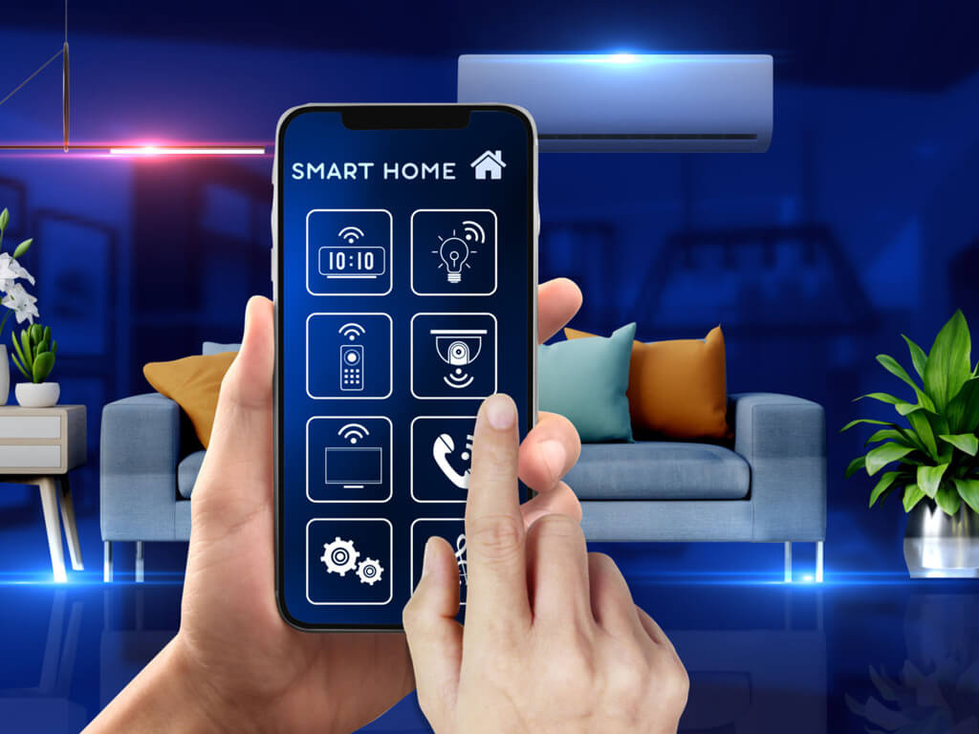
SMART HOME
Technology
NTI TEAM

Slide 2

TEAM MEMBERS
Ahmed Gamal
01
Ola Mohamed
04
02
Elaf Mohamed
05
Fatma Mossad
03
Magdy Khalifa
06
Mostafa Mohamed

Slide 3

TABLE OF CONTANT
Overview
Implementation & Testing
01
04
02
Features
05
Components
03
Requirments
06
Sprints vs Burn up Graph

Slide 4
About Smart Home
A smart home uses connected devices controlled by a smartphone or voice commands to automate tasks, enhance security, save energy, and provide convenience.
Here's a simple overview of key components and benefits of a smart home:
Connected Devices
Smartphone Control
Automation
Voice Control
Security

Slide 5
Features
Lighting Control
Movie Mode
Thermostat Control
Voice Control
Mockapancy
Fire System
Gas Sense
motion Mode
Smart Door Locking
Automated Window
Garage Control

Slide 6
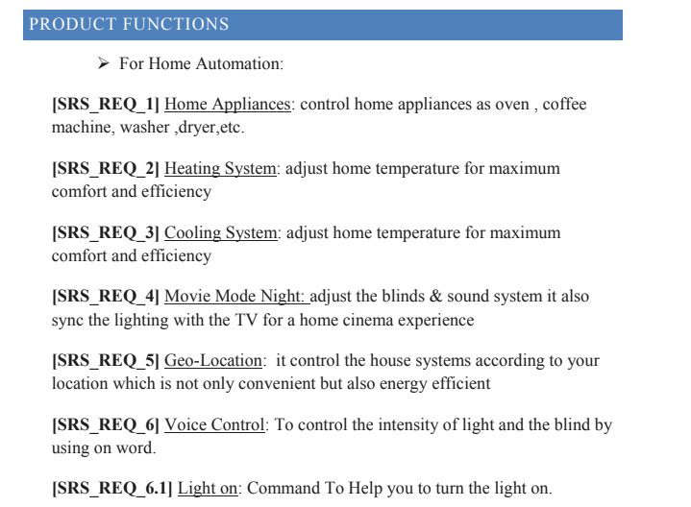
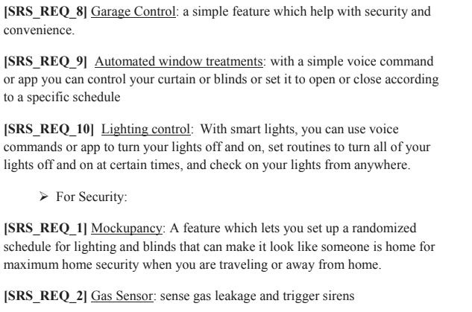
Requirments

Slide 7

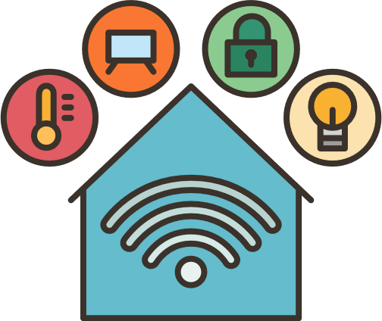
Smart Home System
Security
Routine
Movie Mode
Normal Mode

Slide 8
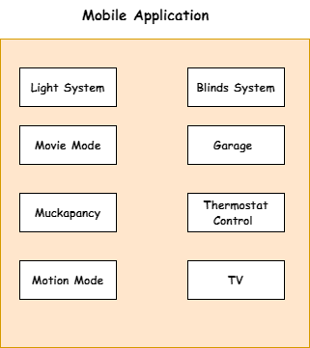
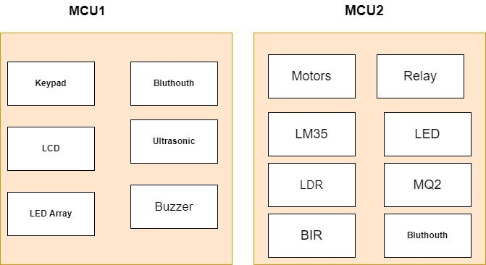
Smart Home System

Slide 9





Smart Home System
Security
Flame
Motion
Gas
Mockapancy
Smart Door Locking

Slide 10
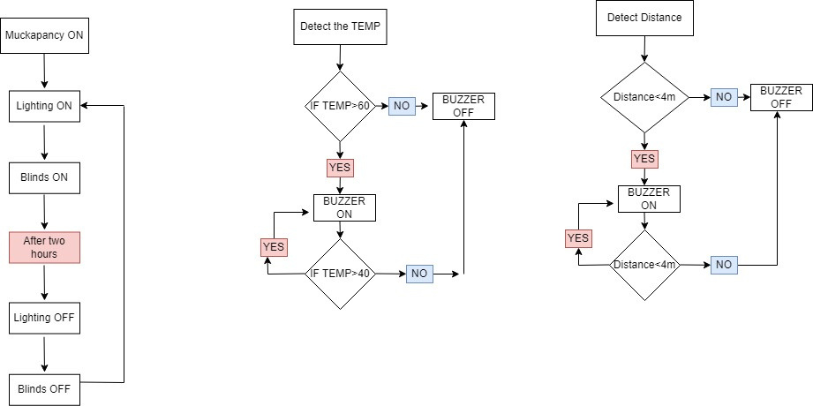
Smart Home System
Security

Slide 11
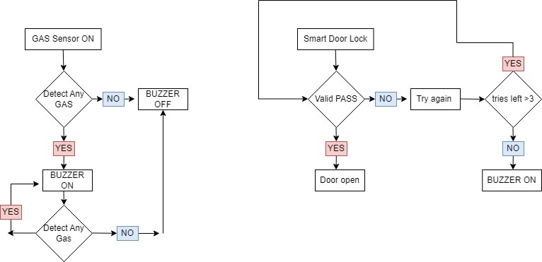
Smart Home System
Security

Slide 12



Smart Home System
Lighting Off
Routine
Close Blinds
Open TV
Movie Mode
Normal Mode

Slide 13



Smart Home System
Garage
Routine
Thermostat control
TV
Movie Mode
Normal Mode
Blinds
Lighting

Slide 14
System Implementation
BSW part1
App
BSW part2
Each team member is assigned a specific driver, while another team member conducts unit testing on it. We divide the system into sub-systems to perform integration testing.

Slide 15
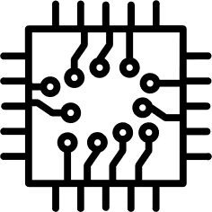
Hardware Components
Keypad
LEDS
Relay
ATMega 32
LCD
Motors
Bluetooth
Buzzer
Sensors
DC
Servo
Ultrasonic
LM35
BIR
LDR

Slide 16






Software App
Draw io
Eclipse
Arduino Blue control
Source Tree
proutes

Slide 17

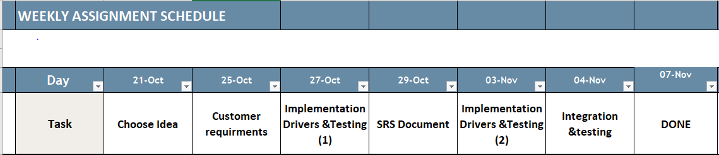
Sprints

Slide 18

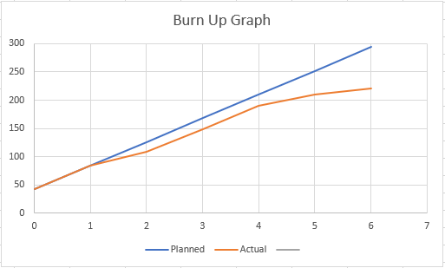
Burn Up Graph

Slide 19

Thank You
For Attention

